Slide 1


MBP Tech Talks presents:
Intro to Machine Learning
Grey Kuling¹
¹ University of Toronto, Faculty of Medical Biophysics
^{Nov, 16, 2018}

Slide 2
Recap of last lecture
  Machine Learning is a form of coding where the user sets up a virtual task using lots of data and trains a ML algorithm to perform better at that task by repeated experience
  Discussed the three types of ML:
    Unsupervised
    Supervised
    Reinforcement
  Discussed Supervised Training:
    Data set split into Training, validation and test set
  Then we reviewed some common ML algorithms and looked at some examples in medicine

Slide 3
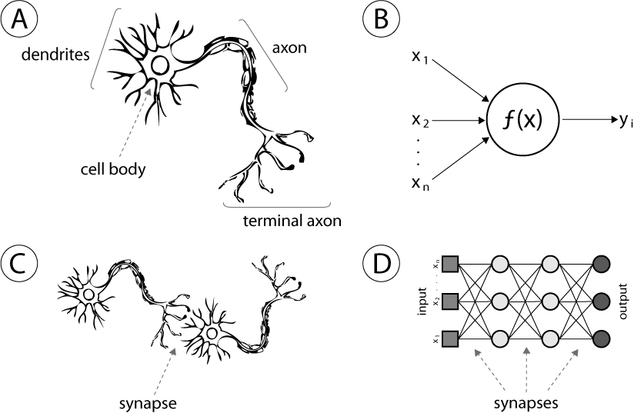
Neural Networks
  Computing systems vaguely inspired by the biological neural networks that constitute an animal brain
  It is a system of nodes connected by edges that transport information onto the next layer depending on their weights and biases
  Another way to think of it is that it is a big forward directed belief network (graph theory)

Slide 4
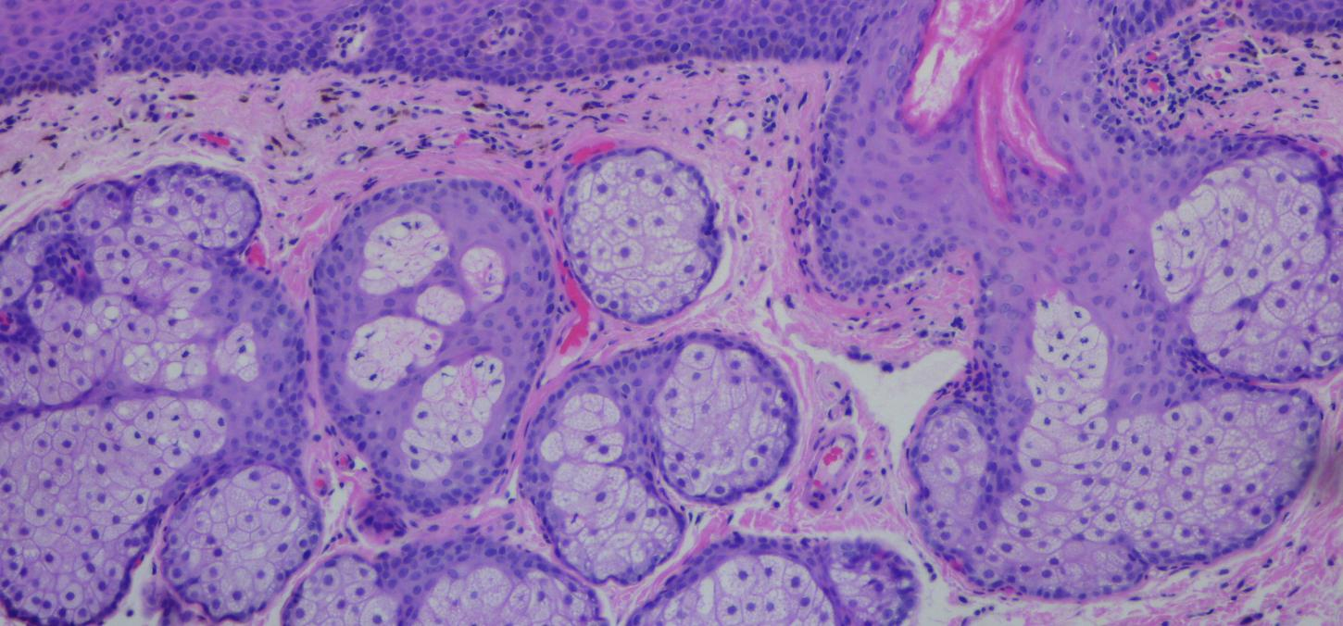
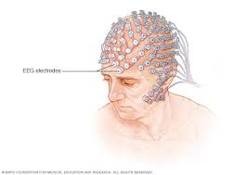
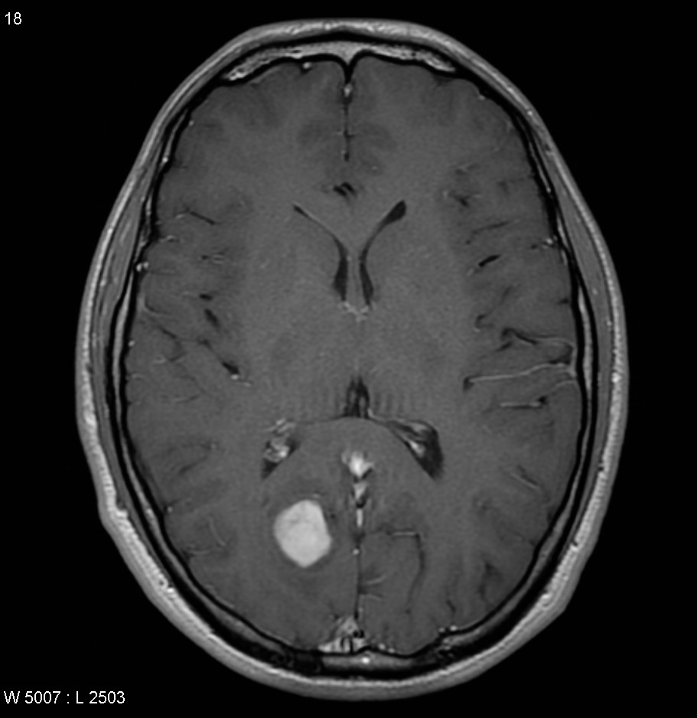
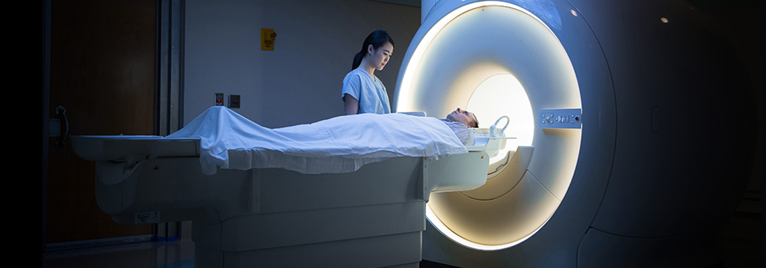
NNs in Medicine
  NNs have been used for many tasks in medicine
    Classification of lesions and tumors
    Diagnosis of cancer based on gene expression
    Dimensionality reduction for data comprehension
    Encoding for image denoising and processing
    Pattern recognition
    Prediction of outcomes and hospital stay length

Slide 5
Neural Networks
  So there is a lot of hype about NNs because they are quite powerful and useful for different data sets and tasks
  The hard part is that NNs have multiple parameters with many MANY options
  Therefore, the use and application is quite tedious because there is a vast amount of ways to use Neural networks
  So we’re going to go through each parameter and give a brief overview of how it works, discuss the training algorithm that is used for NNs, and the add ons that make NNs very powerful
  NNs have the following parameters:
    Nodes and Activation functions
    Loss Function
      Regularization
    Feature learning
    Epoches and Mini-batches
    Backpropoagation
      Gradient descent
      Chain rule
      Optimizers
    Convolutional Filters

Slide 6
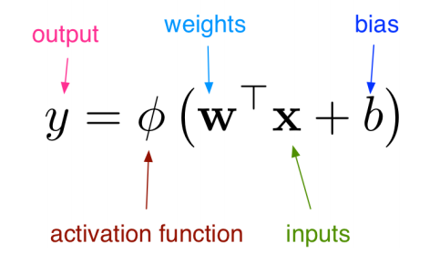
Nodes and Activation Functions
  So each layer of a neural network is a transform of data multiplied by weights, and added in biases
  Then this information is normalized into a set out put using an activation function

Slide 7
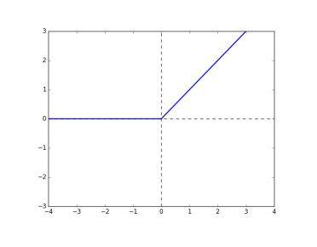
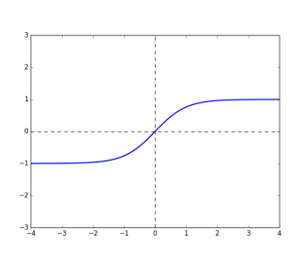
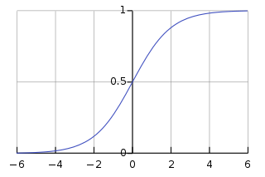
Activation Functions
  Activation function options:
    Rectified Linear Unit (Relu)
    Sigmoid
    Logistic
    Hyperbolic tangent
    Softmax
  These are important for keeping the activations in a specific range when outputted. This makes sure that weights and biases don’t explode during training
Rectified Linear Unit
Sigmoid Function
Hyperbolic Tangent Function

Slide 8
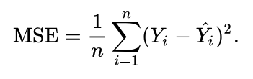

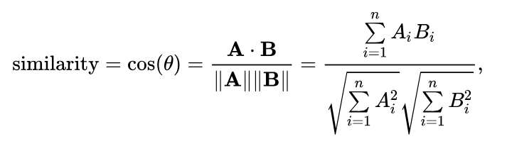
Loss Function
  In optimization, a loss function is a function that maps an event onto a real valued cost function
  This is a function used to quantify how wrong or right the ML algorithm is doing
  Common loss functions:
    Mean squared error
    Cross entropy
    Cosine proximity
  We can find a value for the weights and biases by minimizing the loss function during training

Slide 9




Regularization
  The loss function is typically minimized to find values for W and b
  But sometimes we may not want these values to get too large
  Therefore we add on regularization to restrict the domain of the W and b
  This is typically done with L1-norm, L2-norm or elastic net
  This is typically used to avoid overfitting on a small data set

Slide 10
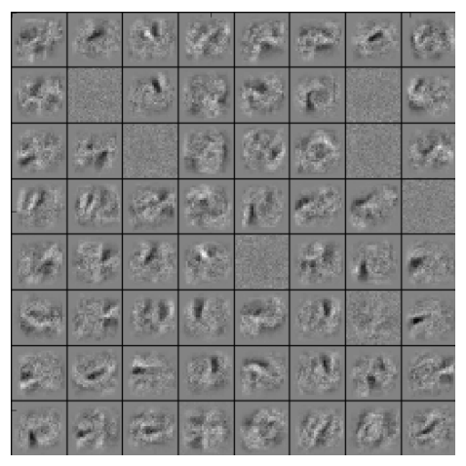
Feature Learning
  What ends up occurring after training is these weights, biases and activation functions adapt to the data
  In the end it learns specific features from the data set to assist in making decision on a test set
  These features are not entirely interpretable but are considered combined linear transformations of the data to a learned feature space to make the data separable for classification

Slide 11
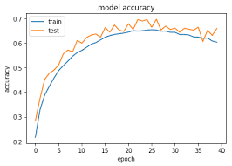
Epoches and mini-batches
  When training there is a possibility to train on everything, but this method is not super efficient for training.
  An Epoch is one whole pass over all the data
  Training has been adapted to update weights more often during an epoch by using mini-batches
  Using mini-batches decreases the training time and increases generalizability of the network

Slide 12
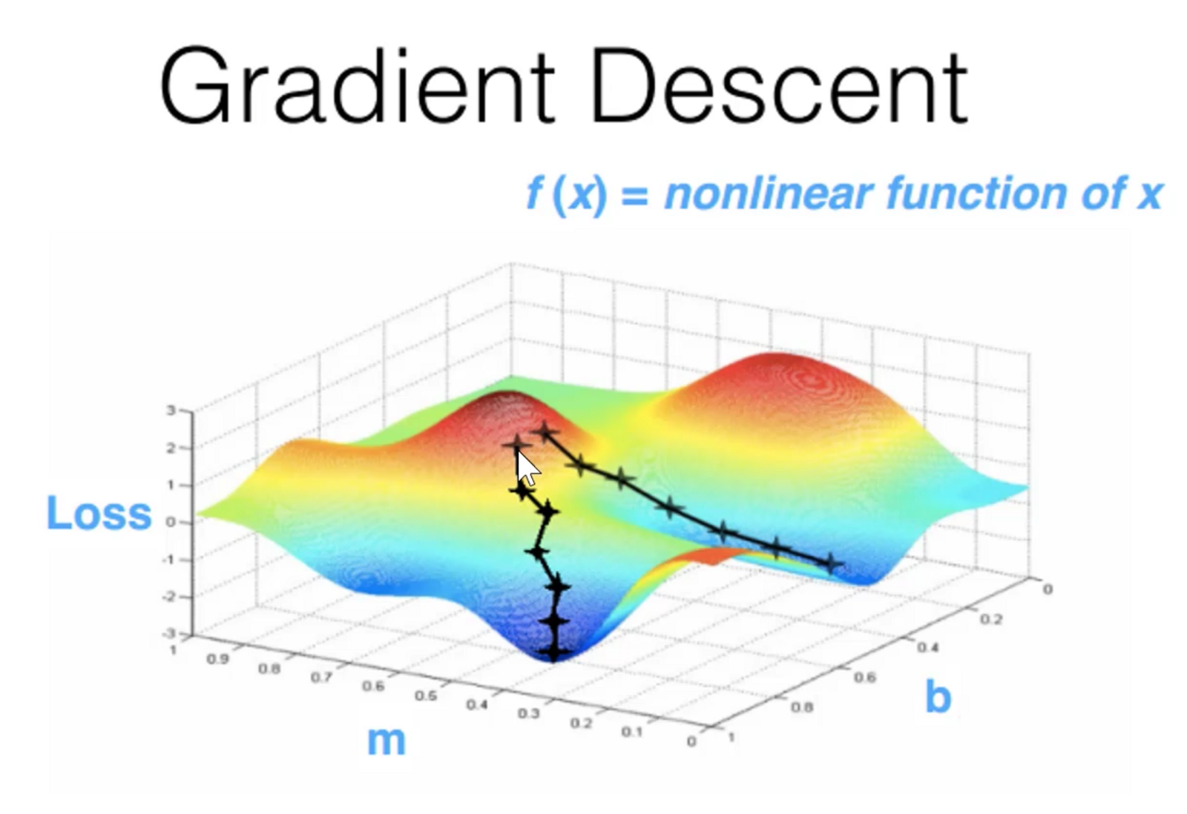
Gradient Descent
  Training and solving for the weights and biases is based on Gradient descent
  GD is a first order iterative optimization algorithm for finding the minimum of a function
  The idea is to evaluate the derivative at the given point and move in the opposite direction of the gradient until you reach a function minimum
  With NNs we want to minimize the loss function with respect to the weights and biases, therefore we do high dimensional gradient descent to solve for the ideal weights and biases
  This technique has a step size which in Machine Learning we call a Learning Rate

Slide 13

Chain Rule
  Before we get into how GD is used to solve for the weights, we should review the chain rule
  The chain rule is used to make the calculation of updates to the weights easier in different layers
  As we can see the chain rule explains the solvable change to a layer’s weights ands biases based on it’s output

Slide 14
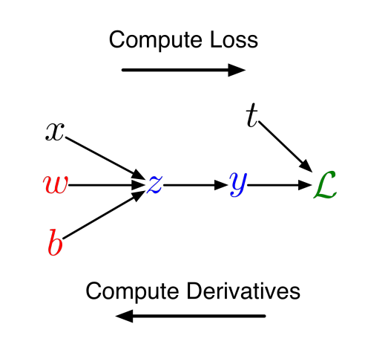
Backpropagation
  Therefore, the use of GD and the chain rule makes it simple to solve for the best weights and biases to give the output we are looking for
  Back prop encompasses 2 phases
    Forward pass: where training examples are put through the network and their loss is averaged
    Backward pass: then each layer’s weights are updated using the chain rule to propagate the error backward
  Thus this system learns the weights by using this very simple optimization algorithm

Slide 15
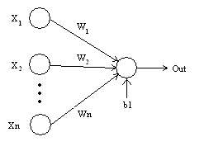
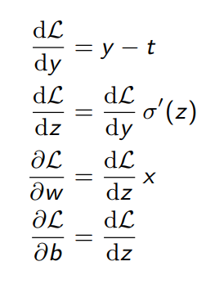
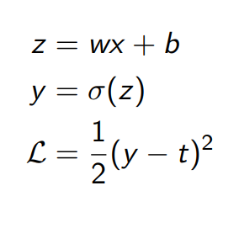
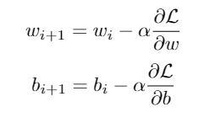
Backpropagation of a single layer NN
The Derivatives Calculated in the Backward Pass
Data Calculation for a Forward Pass
The Update step in the Backward Pass

Slide 16
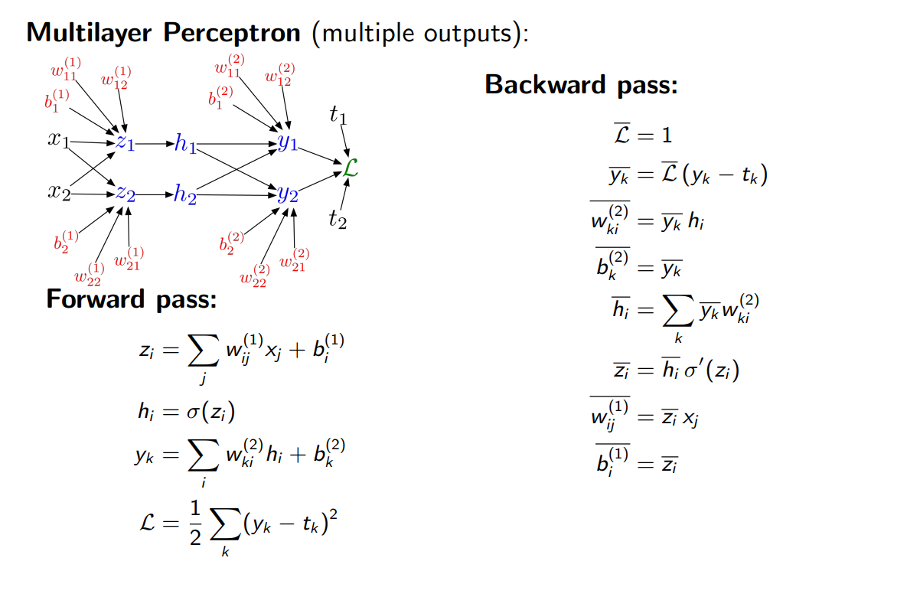
Backpropagation

Slide 17
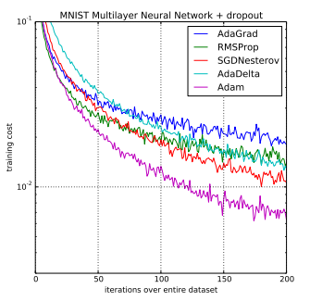
Optimizers
  When it comes GD optimization, there are many options and parameters:
    Learning rate: the step size we take on the surface of the loss
    Momentum: possibility of using the previous step in combination with the current step
    Learning rate schemes: can decay the LR over time
  This results in many different optimizer options.
  The classic is stochastic GD, which takes an average over a mini-batch

Slide 18
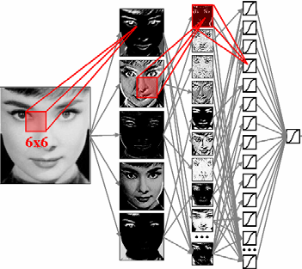
Convolutional filters and CNNs
  Convolutional filters are a means to reduce the dimension of images to make classification easier
  Convolutional filters are a window operation that is multiplied against the image to reduce it into a certain feature space based on the filter window
  CNNs are based on using these filters to increase optimization speed for large inputs and give less weights to update
  This results in CNNs having a more easier time identifying images of specific objects than compressing the info into a linear vector and making that the input of the network
  CNNs also use pooling to reduce the dimensionality of the images to increase discrimination, translation invariance and rotation invariance

Slide 19
Class Activity
  Now we will open our Jupyter notebook and go through a few examples of neural networks on the MNIST data set
  We will be trying to identify hand written numbers in small images

