Slide 1
SCIENTIFIC ILLUSTRATION
MBP Tech Talk
7 December 2018
Jenny Lou & Carly Pellow

Slide 2
Motivation: “a picture is worth 1000 words”
The brain processes images 60 000 times faster than text.
Yet many science images out there are sub-par…

Slide 3
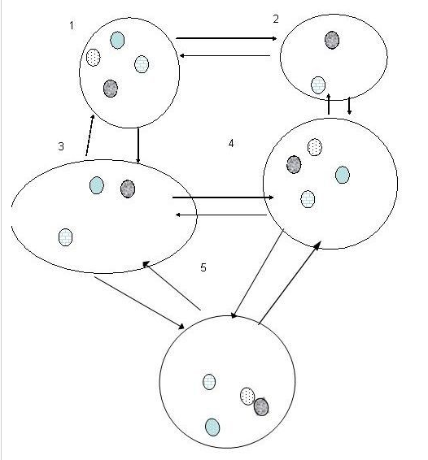
Figure 1. Concept: Collections of local populations of different clones interact in a niche-matrix view of a microenvironment via dispersal of individuals among niches (large ovals).
D. P. Tuck and W. Miranker, Theoretical Biology and Medical Modelling, Vol. 7, No. 44, 2010.
Notes:
MS Paint?

Slide 4
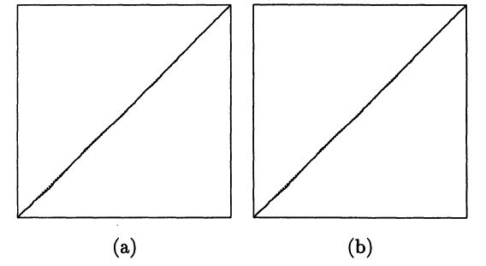
Figure 1. SRQ Plots of Ti/Tn (vertical axes) against i/n (horizontal axes) for the Gibbs Sampler (a) and an Alternating Gibbs/Independence Sampler (b) for the Pump Failure Data Based on Runs of Length 5000. Lines through the origin with unit slope are shown dashed; axis ranges are from 0 to 1 for all axes.
P. Mykland, L. Tierney, B. Yu, Journal of the American Statistical Association. Vol. 90, 1995.

Slide 5
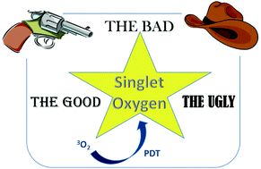
Graphical Abstract.
S. Callaghan and M. O. Senge, Photochemical & Photobiological Sciences, Vol. 11, 2018.

Slide 6
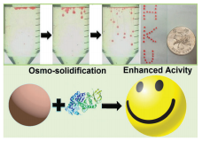
Graphical Abstract.
Q. Ma, et al., Royal Society of Chemistry, 2016.

Slide 7
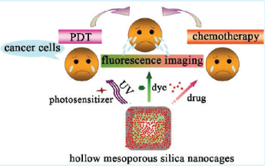
Graphical Abstract.
T. Wang, et al., Applied Materials and Interfaces, Vol. 3, 2011.

Slide 8
Overcoming hurdles to scientific illustration
Even prominent journals will have fascinating findings accompanied by lop-sided figures with strange gradients and terrible colour combinations. Styles aside, they also fail to communicate the scientific story – a sad reality considering the time, energy and resources dedicated to the research.
Hurdle 1: “I’m a scientist, not an artist.”
Hurdle 2: “Making figures takes too long.”

Slide 9
The 6 Principles of Design

Slide 10
Artboard Setup User Interface Vector Persona: -creating curves -pen tool -node tool -setting up grids and snapping -color– fills / strokes -interactions b/w shapes – masking/clipping Pixel Persona: -creating raster graphics -combining with vector persona
Affinity Designer: Quick Start

Slide 11
Create Your Artboard
INSERT ARTBOARDS
SETTINGS

Slide 12
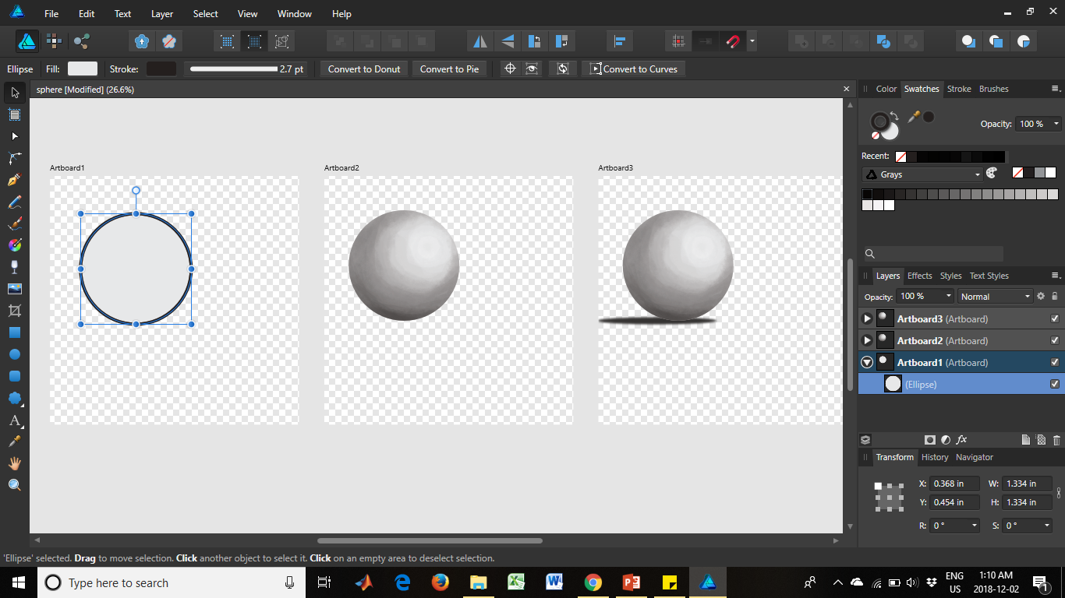
PERSONAS
ARRANGEMENT
SNAPPING
OPERATIONS
TOOLS
ARTBOARDS
STUDIO
Notes:
ARTBOARDS and USER INTERFACE

Slide 13
Tools at Your Disposal

Slide 14
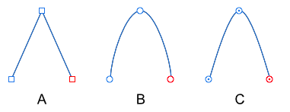
Creating Curves
Curve: open path with distinct start & end
Nodes: endpoints of a curve
PEN
PENCIL
BRUSH
Sharp (A): abrupt changes in direction
Smooth (B): continuous curve
Smart (C): continuous curve with line of best fit

Slide 15
Courtesy of: Developers Club at http://developers-club.com/posts/268283/
Pen Tool

Slide 16
Courtesy of: Developers Club at http://developers-club.com/posts/268283/
Node Tool

Slide 17
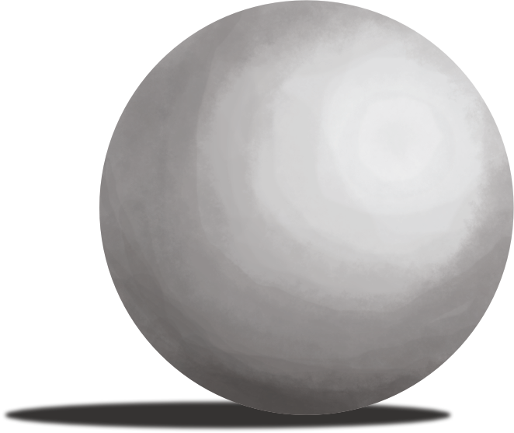
Pixel Persona
Raster Selection
Pixel Editing
Retouching

Slide 18
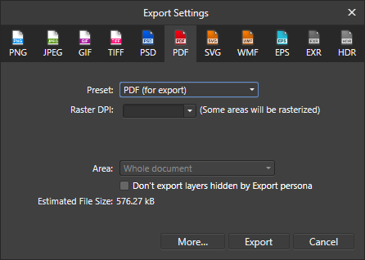
Export Filetype Options

Slide 19
Resources and Alternatives
Affinity Designer Resources:
List of features: https://affinity.serif.com/en-us/designer/desktop/full-feature-list/
FAQ: https://affinity.help/designer/en-US.lproj/index.html
Tutorials: https://vimeo.com/album/3062024; https://vimeo.com/channels/affinitydesigner
Alternatives:
Adobe Illustrator ($$$$)
BioRender (free)
Servier Medical Art (free)
Inkscape (free)

Slide 20
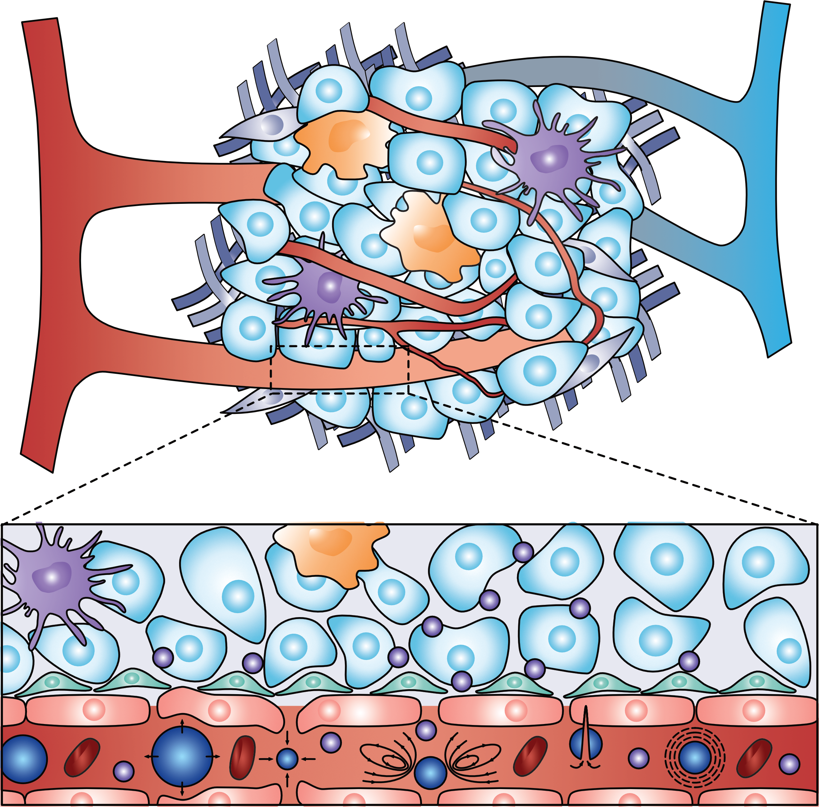

Slide 21
